Slide 1
Typography
1.01 Investigate typefaces and fonts.

Slide 2
What’s the purpose of design?
To grab the reader’s attention
Accomplished through:
Typography
Design Principles
Design Elements
Notes:
Although typography will be the focal point of this PowerPoint, the 3 main topics of objective 1.01 are briefly introduced here.

Slide 3
Something to think about…
"When pictures and words pull in opposite directions and the poor reader doesn't get any message at all, he simply turns the page.“
John Newcomb, Author
Book of Creative Problem Solving

Slide 4
Think-Pair-Share
Who is the target audience for our school newsletter?
What will the target audience expect to see in the newsletter in terms of:
Typefaces used.
Colors used.
Graphics used.
Overall design.
Notes:
Think-Pair-Share is an activity to spark discussion about the objective.
Steps:
Students think (no talking) about the question presented on this slide for one minute.
Students pair with their neighbor and discuss their thoughts for one minute.
Students share their thoughts with the class. Teacher facilitates the discussion.

Slide 5
Typography
the style, arrangement, and appearance of text
Text should:
Be appropriate for the medium used
Increase readability

Slide 6
Typeface Categories
Typeface – the basic design of a character
Typefaces can be divided into four main categories.
Serif
Sans Serif
Ornamental
Script
Symbol

Slide 7
Serif Typefaces
Have strokes at the tips of the letters
Easier to read for printed body text
Examples:
Courier
Times New Roman
k
Notes:
Teachers: You may want to explain that serifs make it easier for the reader’s eye to recognize the difference between letters more quickly. Thus, serif typefaces are better suited for body text of printed material. However, sans serif fonts are easier to read on monitors so web pages will use sans serif typefaces for body text.

Slide 8
Sans Serif Typefaces
No strokes at the tips of the letters
Easier to read on digital displays
Examples:
Arial
Verdana
k

Slide 9
Serif vs. Sans Serif
Serif
The ends of each character do have attributes (serifs)
Sans Serif
The ends of each character do not have attributes (serifs)

Slide 10
Ornamental Typefaces
Designed strictly to catch the eye
Should be used sparingly.
Can be hard to read.
Used for decoration
Should never be used in body text
Examples
Algerian
Bauhaus

Slide 11
Script Typefaces
Appear to have been written by hand
Should never be keyed in all caps
Conveys a formal mood
Examples
French Script
Brush Script
Bradley Hand

Slide 12
Symbol Typefaces
Use decorative pictures or symbols instead of characters
Allows the user to use a symbol to convey the message without importing a graphic
Example: Webdings Webdings
Can be used for specific purposes such as musical notation and mathematical symbols
Example: Mathematical symbol $≠$

Slide 13
Just for fun
Thankfully, I was awakened by the  that flew over my . I did not my ⇦○⇨, and I was almost late for work.

Slide 14
Activity
Open Microsoft Word.
Key your name on 5 different lines.
Change each name on your screen to reflect the following:
SERIF font
SANS SERIF font
ORNAMENTAL font
SCRIPT font
SYMBOL font
Beside each name, label it with the appropriate typeface name and category
For example:
Kathryn Smith
Typeface – Bauhaus; Category - Decorative
Notes:
This is an optional activity to make sure students understand the different typeface categories. Teacher needs to monitor the students to make sure they are choosing fonts in the correct categories.

Slide 15
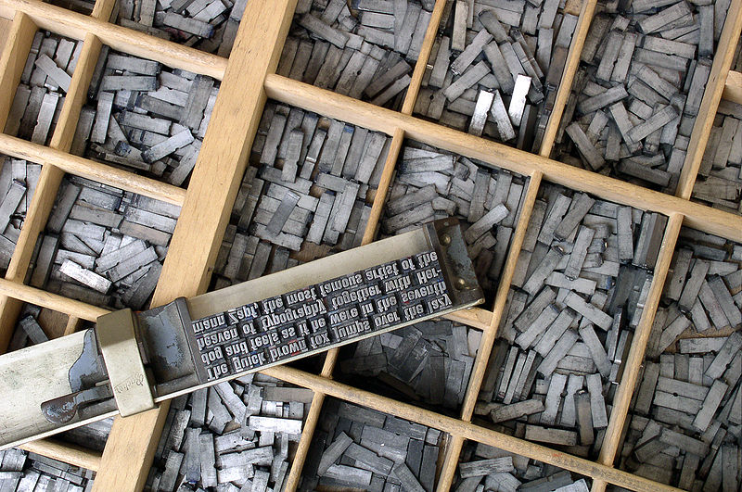
Notes:
It’s easier to understand fonts if you begin with the original definition of a font. Before desktop publishing, people called ‘typesetters’ set the type by hand using moveable type.
Each character was a separate block of metal.
The letters were “set” on the layout to form the text.
Each typeface had a complete set of metal characters for each size, weight, etc.
Each different size or weight required a completely separate set of metal characters.
Each metal set of characters was kept in its own drawer and was called a font.
Just for fun: You can have your students try to read what it says.

Slide 16
Fonts
Font - the specific size, weight and style applied to a typeface.
Examples: Arial, bold, 12 point
Arial, italic, 14 point
Arial, 10 point
Arial is the typeface. Arial, bold, 12 point is the font.

Slide 17
Font Style
The font style refers to the slant, weight and special effects applied to the text.
Examples:
Bold
Italic
Shadow
Stroke
Fill Color
Small Caps

Slide 18
Typeface spacing
Monospace
Proportional

Slide 19
Monospaced Typefaces
Each character takes up the same amount of horizontal space
Harder to read in large bodies of text
Courier is monospaced

Slide 20
Proportional Typefaces
Proportional
The amount of horizontal space each character takes up varies.
An i is not as wide as an m and receives less space.
Better for body text
Courier is monospaced
Times New Roman is proportional

Slide 21
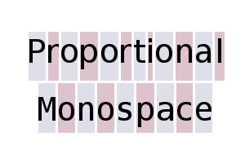
Proportional vs. Monospace

