Slide 1
Graphic Design Features
Obj. 1.02

Slide 2
Graphics
Illustrations and photographs used to convey meaning and add appeal

Slide 3

Bleed
A print effect in which a color or an object appears to run off the edge of a page

Slide 4
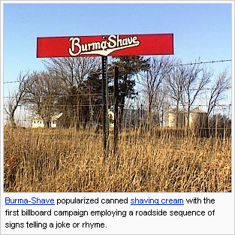
Caption
Brief descriptive text, usually placed near an image

Slide 5
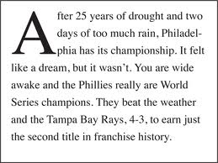
Dropped Cap
An enlarged character at the beginning of a paragraph
Drops below the line of text
Grabs the reader’s attention

Slide 6
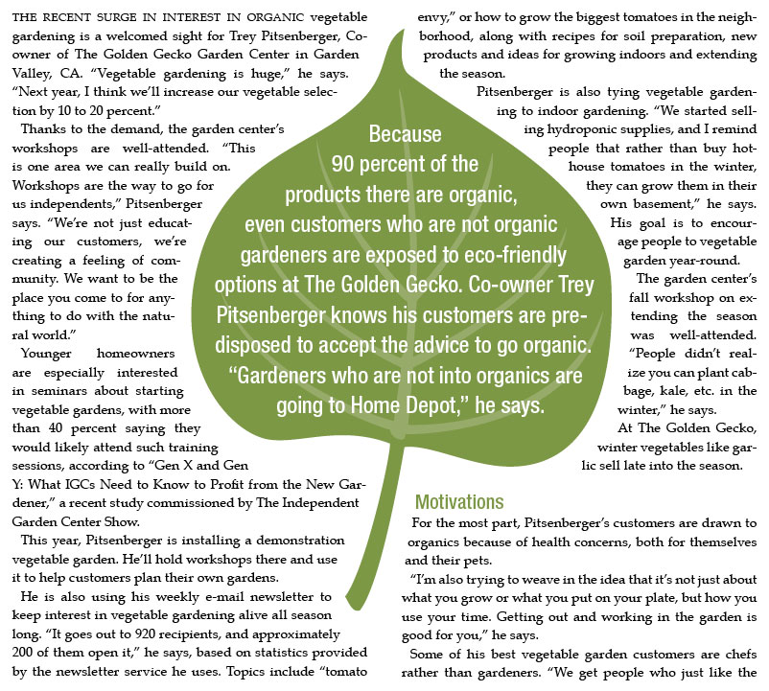
Pull Quote
Quotation taken directly from the body of the article
Used to draw attention
Often made larger
Can be placed
  Between columns
  Alone in a column
  Right justified
  Beneath the headline

Slide 7
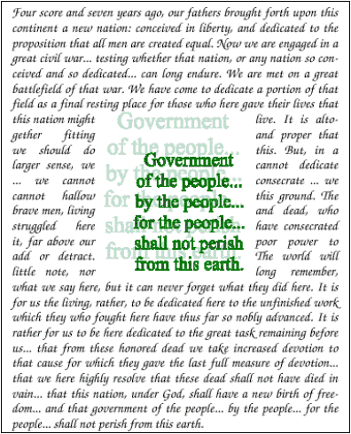
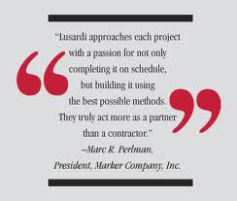
Notes:
More examples of pull quotes

Slide 8
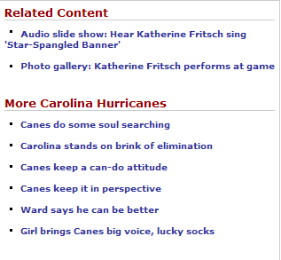
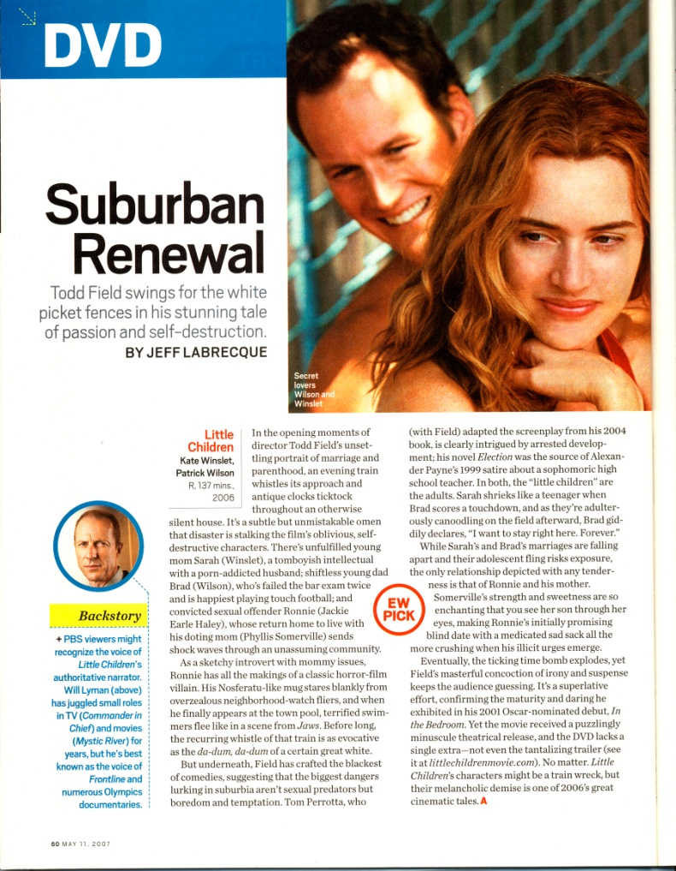
Sidebar
Smaller, self-contained story alongside a larger story

Slide 9
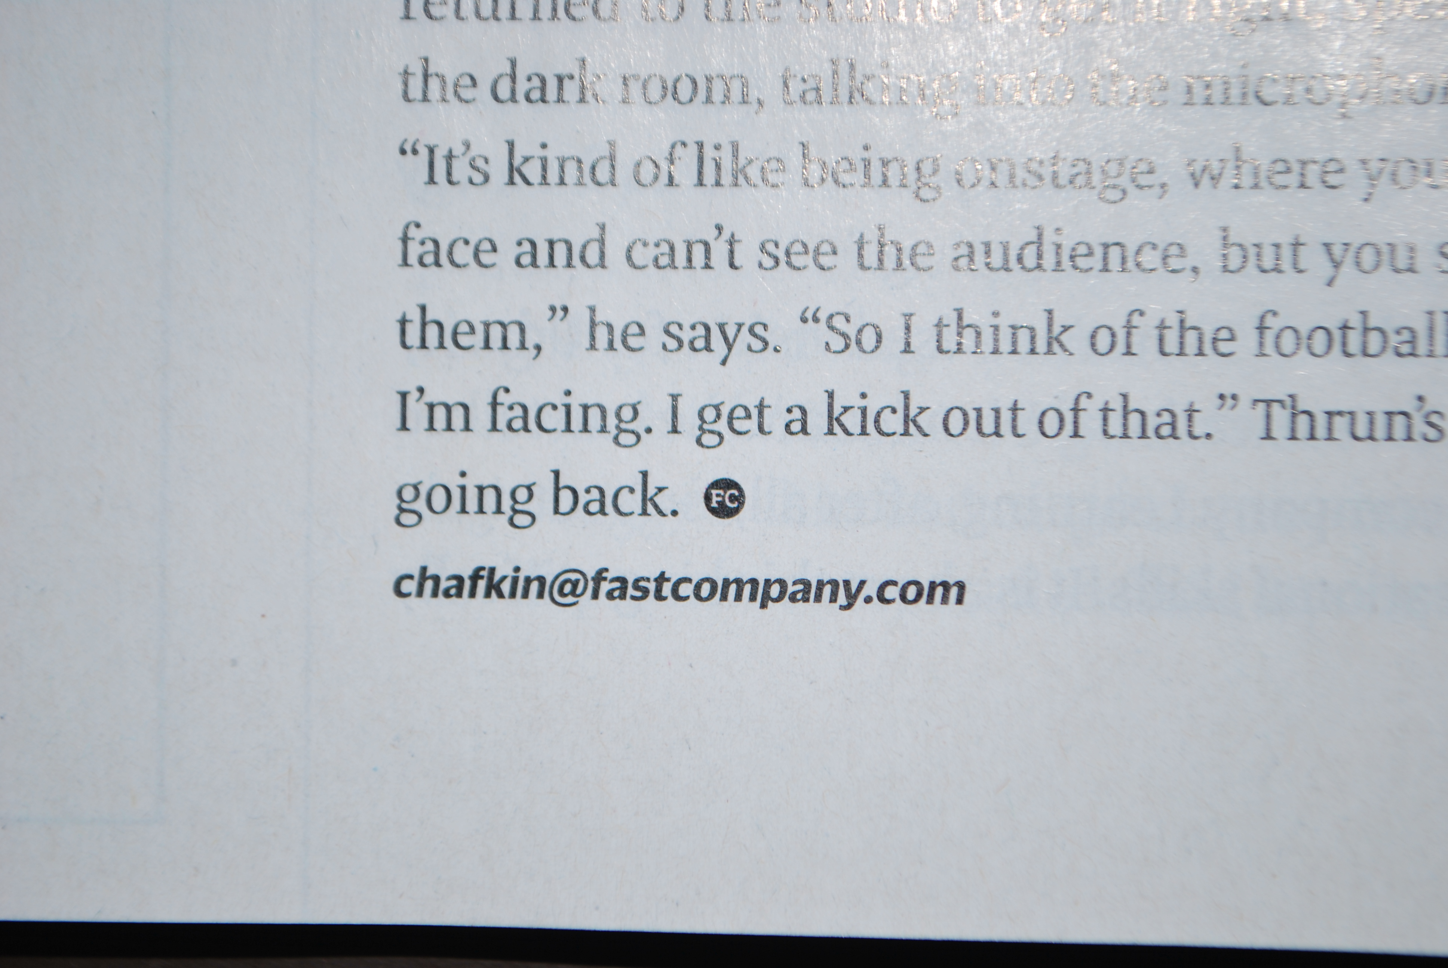
End Mark
A symbol used to indicate the end of an article or news item♦

Slide 10
Title & Heading Information
Nameplate – banner on the front of a document
  identifies the publication
  includes the name of the publication, a logo, and a motto

Slide 11
Headings & Subheadings
Main Heading – title of the article, usually set in a larger font
Subheadings – subtitles
  usually set in a smaller font than the title
  can be used to break up body copy

Slide 12
Byline
Gives credit to the author or contributor of photo or article
Usually placed just below the headline or photo or at the beginning or end of the article

Slide 13
Kicker & Deck
Kicker – words positioned above a headline, usually as a lead in or teaser
Deck – placed between a headline and an article to provide a segue between the headline and the body of the article

Slide 14
Body
The bulk of the publication
  Paragraphs – use paragraph settings to adjust the space between paragraphs
  Characters – use fonts, styles, leading, kerning, and tracking to enhance the publication

Slide 15
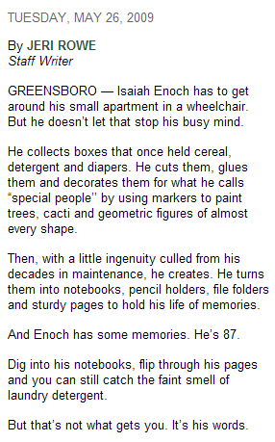
Jumpline
tells readers which page to refer to for the continuation of an article
Continued on B3
Notes:
15

Slide 16

Running Headlines/Footers
Running text at the top and/or bottom of a document.
Used for identifying information, page numbers, date, section titles

Slide 17
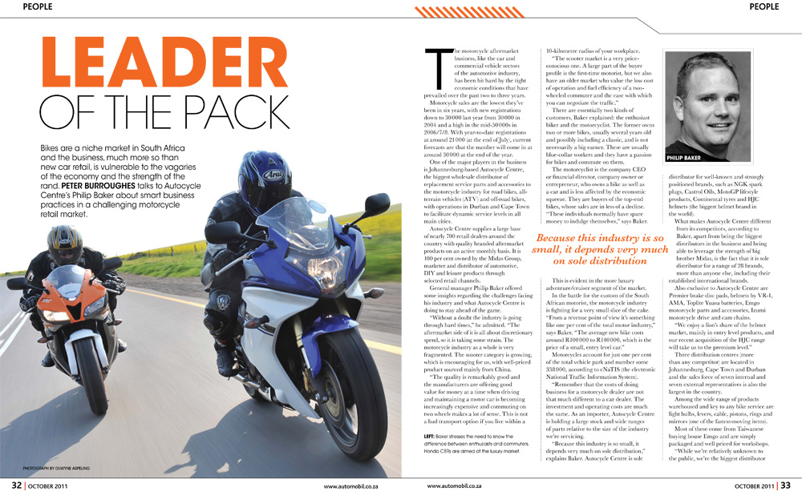
What can you find in this layout?
Notes:
This layout has the following design examples to be discussed with students: Graphic, Bleed, Dropped Cap, Pull Quote, Main Heading, Byline for the photograph, Deck, Caption, Running Headline, Running Footer, Body

