Slide 1
Graphic Design Layout Options
Obj. 1.02

Slide 2
Templates
Standard pre-formatted layouts
May contain a color scheme, font scheme, pictures, and preset margins
Notes:
Instruct students on where to find templates in the software available in your classroom. Show examples of the print-layout designs discussed in this objective, such as the business card, letterhead, etc.

Slide 3
Working with Grids
organizing content on a page, using any combination of margins, guides, rows and columns.
Commonly seen in web design and in newspaper and magazine layouts with columns of text and images.
Used to achieve a consistent look and feel
Notes:
For more information, visit http://www.thegridsystem.org/
Pre-designed grid systems are usually built into the software for students to use. Students should be taught how to use and adjust all the guides discussed in this objective.

Slide 4
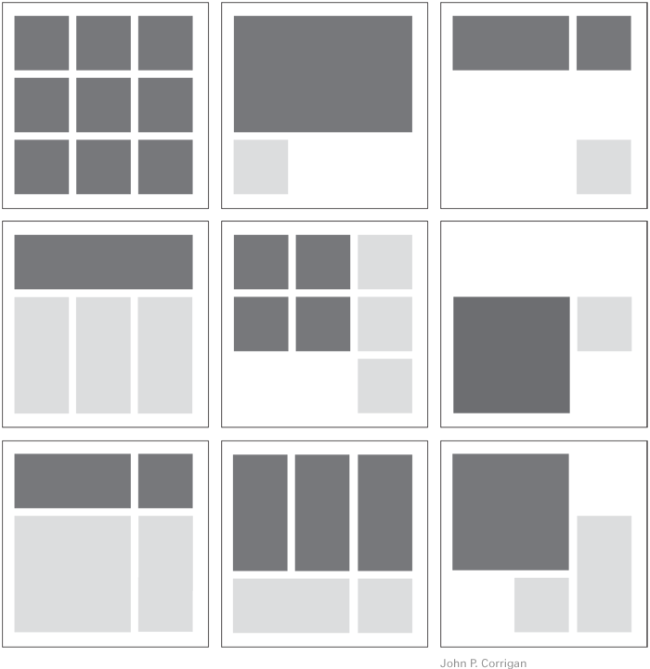
Notes:
Examples of layouts with grids

Slide 5
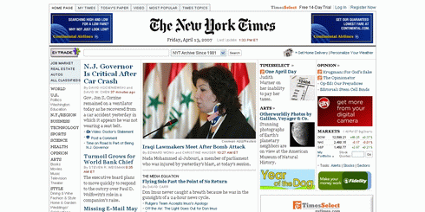
Notes:
Example of a newspaper with grids from www.nytimes.com

Slide 6
Guides
non-printing lines used to assist the developer in placing objects
Margin guides – indicate the space between the edge of the page and the document contents
Column guides – control the flow of text within columns
Gutter - space between columns
Ruler guides – used to precisely align objects
Notes:
Instruct students on how to add and adjust guide lines in the software available to you.

Slide 7
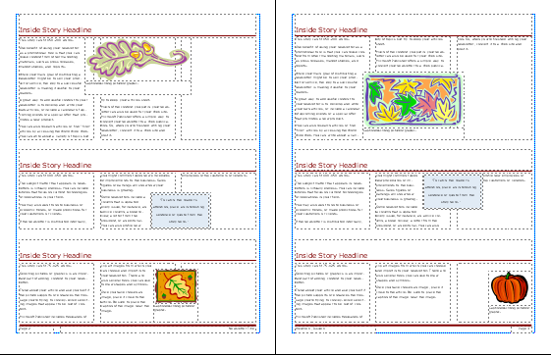
Example from Publisher
Column Guides
Margin Guides
Gutter

Slide 8
Formatting Considerations
Page size – varies according to publication
Master page – includes items and formats common to every page; used to maintain layout consistency
Prototype – (also called mockup) an example of how the final document should appear
Notes:
Instruct students on how to adjust page size and use master pages according to the software available in your classroom.

