Slide 1
Creating Vectors – Part One
2.02 Understand Digital Vector Graphics

Slide 2
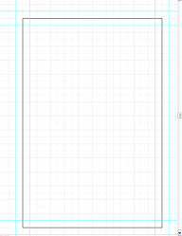
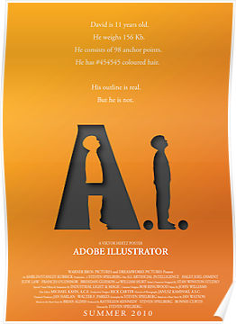
Creating Vectors
Artboard – the area that contains the printable part of your artwork.
Objects – any shape, image, or text that can be moved, scaled, or edited.

Slide 3
Creating Lines
Lines - an open ended path with two anchor points, which included straight, beziers, and spirals.
Anchor point – basic component of paths, which appear at the start and end of every path or where it changes direction.
Line segment – part of a line that has an anchor point one each end.
Path – made up of one or more line segments, connected by two or more anchor points or nodes.
Open path – one or more paths for which the start point and end point are not the same, for example a straight or curved line.
Closed path – a continuous path that has no beginning or end, for example a circle or rectangle.

Slide 4
Creating Shapes
Shapes - geometric based tools that allow you to create primitive shapes, such as rectangles, ellipses, and polygons.
Transformations – scaling, rotation, shearing (skewing), and reflecting (flipping) objects to change their appearance.

Slide 5
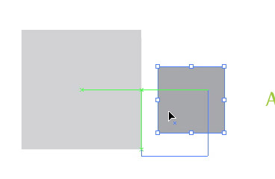
Aligning and Arranging
Smart Guides – guides that appear as you move around a document indicating various points of alignment with existing objects. For example, you can use smart guides to align objects with the edges or center point of other objects.
Stacking Order – the order of how objects are arranged on the artboard, in front of or behind each other. By default new objects are created at the front of the stacking order.

Slide 6
Selecting Objects
Selection tool - selects an object or a group of objects.
Allows you to transform the object.
Direction Selection tool - selects individual anchor points or line segments in order to edit individual pieces of an object.
You can move the anchor points or line segments in any direction.

Slide 7
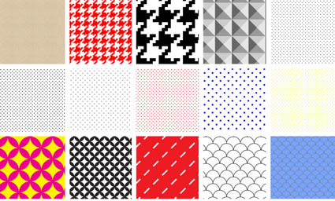
Colors and Fills
Stroke – the visible outline of a shape or path, such as the color, weight, or style, which is not the same as a path as a path can have no stroke as an option.
Fill – to put a color, gradient, or pattern into an object.
Swatches – named colors tints, gradients, and patterns.
Gradients – filling an object with a smooth transition from one color to another.
Patterns – a repeated (tiled) decorative design.

