Slide 1
Creating Vectors – Part Two
2.02 Understand Digital Vector Graphics

Slide 2
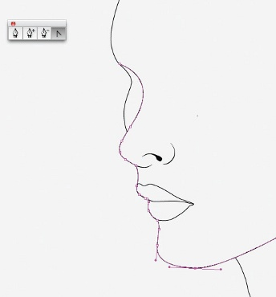
Drawing
Drawing – using shapes or other tools such as the pen or pencil to simulate the experience of drawing on paper.
Pen tool – it uses anchor points and paths to allow you to create straight lines, Bezier lines (curved), and shapes in a countless amount of combinations. Considered one of the most powerful tools in graphic design.
Bezier – a curved segment of a path which uses handles to control the shape of the curve.

Slide 3
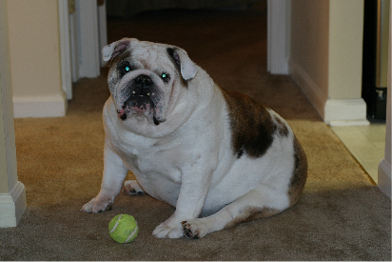
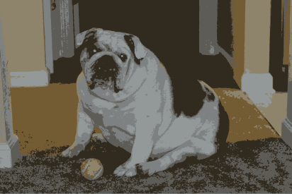
Tracing
Image Trace – a tool in a vector program will take a raster image or scanned drawing and automatically convert it to paths, based on selected settings.

Slide 4
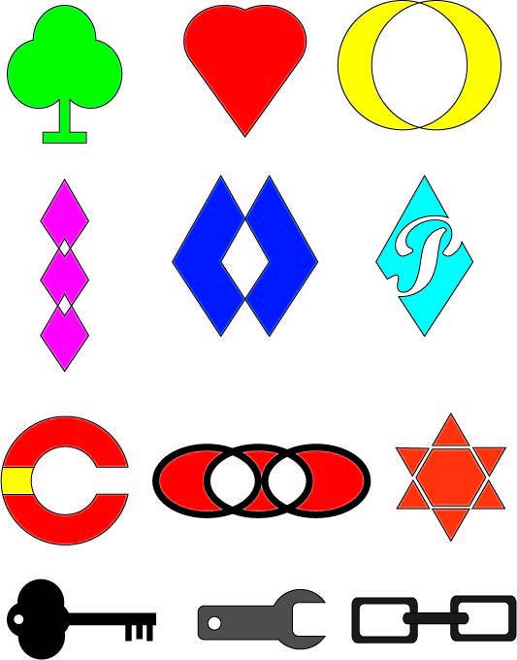
The Pathfinder
Pathfinder – a tool that contains four shape options and six pathfinder options that allow you combine multiple objects in a variety to way to create complex shapes. Some options include:
Unite – combines all selected shapes into one shape.
Minus Front – subtracts the top shape from the bottom most shape.
Minus Back – subtracts the bottom shape from the top shape.
Divide – separates the selected shapes in individual parts.
Notes:
This image is taken from an instructional exercise, so you may want to see if the students can figure out how one or two were created.

Slide 5
Effects
Vector Effects – commands that can be applied to an object, group, or layer to change its characteristics, such as distort and transform, warp, and stylize.

Slide 6
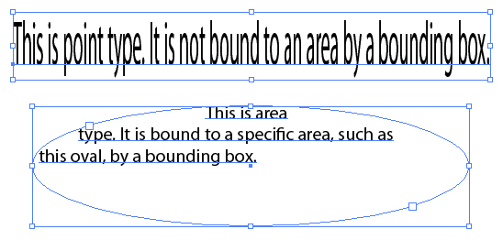
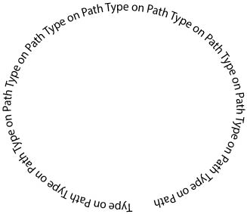
Type
Point Type – a line of text that begins at the point that you click, which expands as you type. The type will not automatically wrap to the next line, you must use enter.
Area Type – uses the boundaries of an area created by dragging a marquee with the type tool to control the flow of text. When text gets to the end of the boundary, it automatically wraps to the next line.
Type on Path – allows you to attach text to an open or closed path.
Text Wrap – controls how area text flows over or around objects and images.

