Slide 1
Introduction to Digital Video

Slide 2
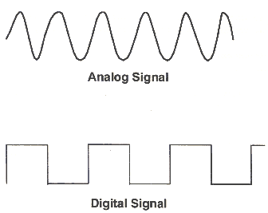
Digital Video
Digital vs. Analog
Analog video uses a continuous electrical signal to capture footage on a magnetic tape. Examples would include VHS, 8mm.
Digital videos are made up of 1’s and 0’s, binary format, that represent the video image which computers can read.

Slide 3
Digital Video Terms
Capture: To record audio, video, or still images as digital data in a file.
Frame: a single picture or still shot, that is one of many sequential images that make up video.
Frame Rate: The number of video frames displayed per second (FPS). Higher frame rates generally produce smoother movement in the picture.
NTSC Television: 24 fps (23.976). Worldwide standard for movie theater projectors and television.
Many movies are now being shot at higher frame rates, such as 30 fps or 48 fps (HFR).

Slide 4
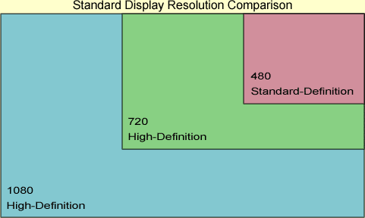
Digital Terms (Continued)
Display Resolution: the number of pixels that can be displayed on a digital screen, usually quoted as width x height.
(480p): 720 x480
NTSC DV (Television) and DVD standard.
(720p): 1280 x 720
HD Video capable of high frame rates, but smaller dimensions than 1080p.
(1080p): 1920 x 1080
HD Video with high resolution.

Slide 5
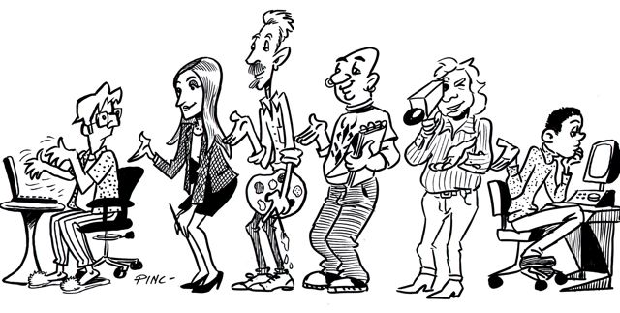
Phases of Video Production
Preproduction
Production
Postproduction

Slide 6
Preproduction
The events that take place prior to the actual shooting of the video.
Idea Generation (Brainstorming)
Producing ideas through spontaneous group discussion.
Lets Brainstorm: As a class come up with ten ideas for a new comedy show that would target young people. Example: A show about a family can talk to their pets. Each pets personality fits their species: dogs are simple, cats are snotty, hamster is energetic.
Script Writing
The written text for your movie.

Slide 7
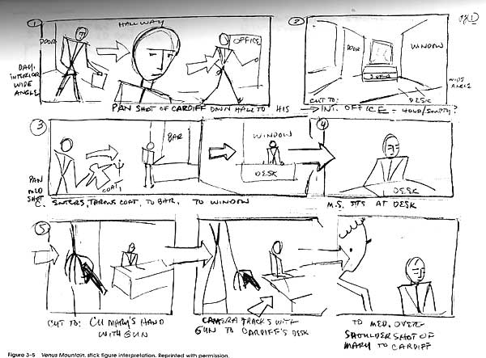
Preproduction (Continued)
Storyboarding
A sequence of drawings, with directions and sometimes dialog, that represents planned shots for a movie.

Slide 8
Preproduction (Continued)
Casting - finding appropriate people to play the roles of the video
Scouting Locations
Look and feel
Associated cost
Lighting
Permission
Logistics
Power
Distance
Parking

Slide 9
Production
The actual shooting/recording of the video.
Framing Shots/Field of View
Shot Types: Wide, Medium, Tight
Panning and Zooming
Panning
Zooming
Audio
Microphone Choice: On Board, Shotgun Mic, Boom Mic
Lighting
Natural vs. Artificial

Slide 10
Postproduction
All events between production and creating the final version of the video.
Capturing Video - importing video from the original recording device.
Trimming Clips and Creating Sequences
Clips: Small segments of a larger video.
Trim: To hide parts of a file or clip without deleting them from the original source.
Sequence: A variety of wide, medium, and tight video shots edited together to compress time, add interest, and help the viewer movie efficiently through a story.
Timeline: Shows the components of the movie such as photos, video, audio clips and titles in the order and timing that they will appear in movie.

Slide 11
Postproduction (Continued)
Adding Titles and Graphics
Rolling credits- Include cast and credits for sources.
Adding/Editing Sound
Soundtracks or sound effects: Additional audio added as background or to enhance specific points in the video.
Narration: Audio of one or more people that has been recorded to enhance or assist in telling the story for your video.
Apply Effects
Transitions: The visual movements as one picture, video clip, or title changes to another. Transitions are not applied directly to the clips, but are used to move from one to another. (Common: Cross Dissolve)
Video Effects: Enable you to add special effects to your movie. An example would be adding a Film Age video effect to make your movie clip to look like that of an old time movie or making the video black and white.

Slide 12
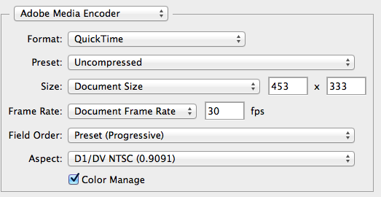
Postproduction (Continued)
Exporting
Common Video File Types
.avi (Audio Video Interleave)
Created by Microsoft; Uses less compression than MOV or MPEG; Supported by almost all computers using Windows
.mov (Apple Movie)
Developed by Apple Computer; Cross-Platform; Opens with Apple QuickTime
.mp4 (MPEG-4)
Developed by Moving Pictures Expert Group; Compresses well; Commonly used for the Internet
.flv (Flash Video)
Developed by Adobe Systems; Commonly used to deliver video over the Internet by using Flash Player; Used by YouTube, Hulu, VEVO, etc…

