Slide 1
4.01 Cascading Style Sheets
An introduction to 3 types of CSS

Slide 2
Introduction
This presentation introduces the following:
3 types of CSS
CSS syntax
CSS comments
CSS and color
The box model

Slide 3
Why we need CSS
Styles were added to HTML 4.0 because HTML has very few formatting tags.
Styles define how to display HTML elements
There are 3 types of CSS: Inline, Internal and External.
Notes:
The HTML formatting tags are in the optional section of the curriculum. Emphasis is placed on using CSS to style documents.

Slide 4
3 Types of CSS
Inline Styles use the style attribute within an HTML tag. Inline styles only apply to that single instance of an HTML element.
Internal Styles are contained in the head section and style a single web page.
External Styles are saved in an external .css file. A single external style sheet can style an entire web site.
Notes:
Emphasize that the styles cascade. All 3 types can be used in a document.

Slide 5
Inline Styles
The syntax for an inline style:
<element-name style="property: value;">
Example:
<body style="background-color: black;">
Multiple CSS property:value pairs can be entered in the same style attribute

Slide 6
Use Inline Styles Sparingly
Inline styles use the style attribute in the relevant tag.
Each instance must be styled.
Internal and External styles save time and are easier to update.
Notes:
Emphasize that this is the style attribute not the style tag

Slide 7
Internal Styles
Internal CSS styles a single web page according to the rules entered in the <head> section of the document.
The <style> tag is required.
CSS rules have two parts: a selector and one or more declarations.
The selector is the HTML element to be styled.
The declaration specifies the property and value.

Slide 8
When to use Internal CSS
Use Internal CSS when a single document has a unique style.
The <style> tag must be in the <head> section of the HTML page.
<head>
<style>
body {background-color: black; }
p {color: white; }
</style>
</head>

Slide 9
Internal CSS

Slide 10
CSS Rule for h1
Heading 1 will display in text color blue and a 12 pixel font.

Slide 11
CSS selectors can appear in one line
<html>
<head>
<style type="text/css">
body {background-color: black; }
p {color: white; }
</style> </head>
<body>
<p>White text on a black background!</p>
</body> </html>

Slide 12
CSS selectors can appear in multiple lines
<html>
<head>
<style type="text/css">
body
{
background-color: black;
}
P
{
color: white;
}
</style> </head>
<body>
<p>White text on a black background!</p>
</body> </html>

Slide 13
External CSS uses link tag
<head> <link rel="stylesheet" type="text/css" href="mystyle.css"> </head>
Notes:
Emphasize that <link> must be in <head>

Slide 14
When to use External CSS
External CSS is ideal when the styles should be applied to many pages.
The styles in one file can be changed and the look of the entire web site will be updated.
External styles can be written in a text editor.
The file is then saved with .css extension.
Notes:
CSS files are text files.

Slide 15
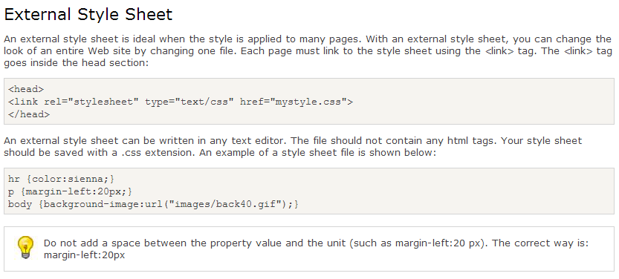
External CSS

Slide 16
Multiple Style Sheets
Multiple styles will cascade into one
Inline styles have highest priority, then Internal styles, then External styles and then the Web browser default.

Slide 17
CSS Comments
Comments are used to explain your code, and may help you when you edit the source code at a later date. Comments are ignored by browsers.
A CSS comment begins with "/*", and ends with "*/“.
CSS comments are different from HTML comments. They are two different languages.

Slide 18
CSS and Colors
In CSS color is most often specified as either a HEX value (#ff0000), an RGB value (rgb(255,0,0) or a color name (red).
Refer to a color chart for a complete list of values.
Notes:
You may want to visit http://w3schools.com/html/html_colors.asp

Slide 19
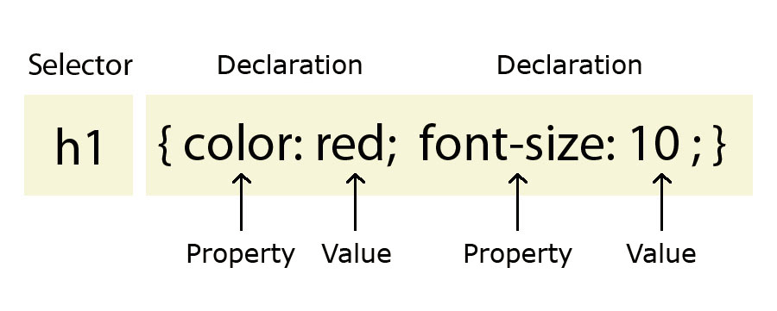
CSS color controls text color

Slide 20
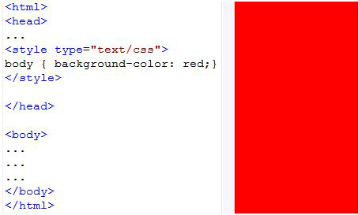
CSS background-color

Slide 21
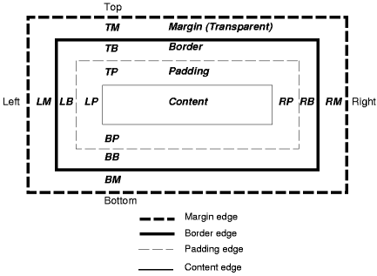
The CSS Box Model
Notes:
This is a conceptual model that relates to layout and objects.

Slide 22
What is the Box Model?
All HTML elements can be considered as boxes. In CSS, the term "box model" is used when talking about design and layout.
The CSS box model is essentially a box that wraps around HTML elements, and it consists of: margins, borders, padding, and the actual content.
The box model allows us to place a border around elements and space elements in relation to other elements.
Notes:
An example of the box model is using margins, padding or borders around images.

Slide 23
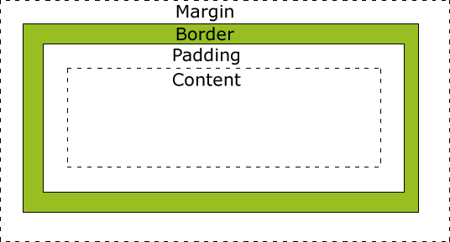
The Box Model helps us understand the size of elements
Important: When you set the width and height properties of an element with CSS, you just set the width and height of the content area. To calculate the full size of an element, you must also add the padding, borders and margins.

Slide 24
Box Model applied
CSS Coding for an img
img
{
width:250px; padding:10px; border:5px solid gray; margin:10px;
}
Here is the math for this element
250px (width) + 20px (left + right padding) + 10px (left + right border) + 20px (left + right margin) = 300px

