Slide 1
4.01 How Web Pages Work

Slide 2

Introduction
Topics in this presentation:
The Web and how it works
Difference between Web pages and web sites
Web browsers and Web servers
HTML purpose and structure
W3C and Standards

Slide 3
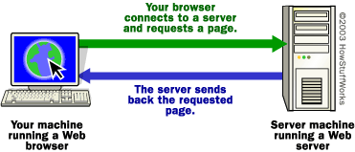
Simplified Explanation of Web browser and Web Server
The content on the Web is available because the Web is a network of computers all over the world.
The interconnected devices on the Web use a communication standard known as http (hypertext transfer protocol).

Slide 4
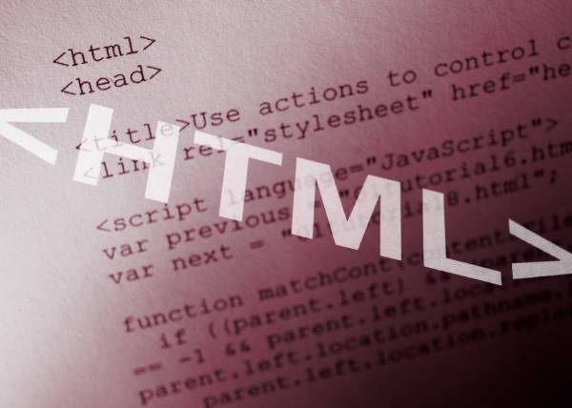
What are Web Pages
A web page is a document which can display text, graphics, audio, video and other elements through a web browser.
Web pages are documents stored on web servers.
Web pages contain instructions on how to display content. The most common instructions are in hypertext markup language (HTML).

Slide 5



You request a web document through your Web browser.
DNS Server
Checks domain name and finds address of web server
Client computing device
Web Host or Web Server
Sends requested document to your browser

Slide 6
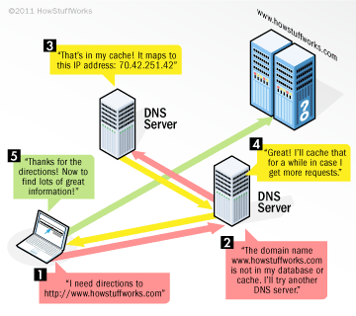
DNS Servers and IP addresses

Slide 7
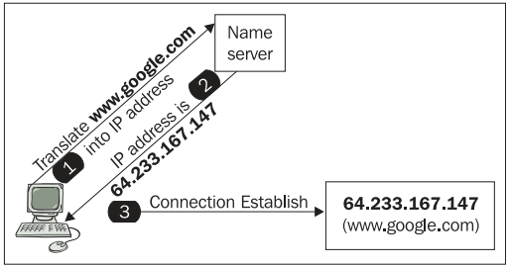
IP addresses are required
An IP address is a unique string of numbers separated by periods that identifies each computer using the Internet Protocol to communicate over a network

Slide 8

Role of the Web Browser
HTML code is interpreted by a web browser. (a software application designed to retrieve and present content on the Web)
The web browser fetches a Web page from a server by a request. A standard http request includes a page address. For example: http://www.w3.org/standards/about.html

Slide 9
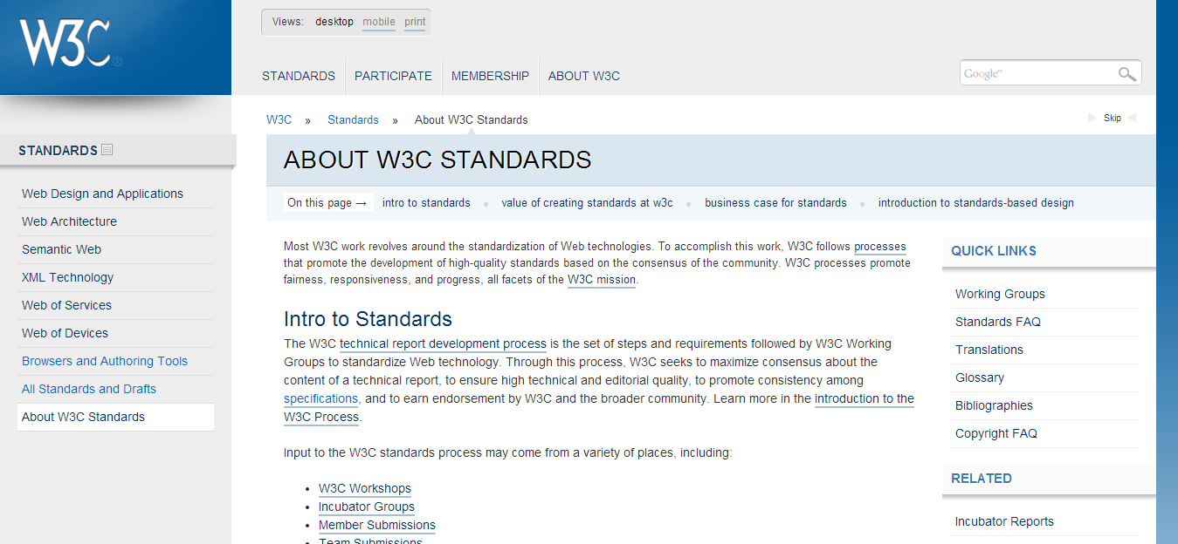
http://www.w3.org/standards/about.html

Slide 10
HTML is a markup language which means that special codes are used to define elements. It is not a scripting or a programming language.
HTML Defined
HTML code is often referred to as source code. HTML can be coded using a plain text editor.

Slide 11
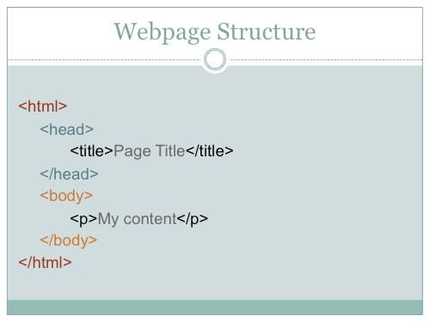
HTML Structure

Slide 12

Role of the Web Server
Web servers are also called web hosts.
The web server fetches pages by request and sends them to the client’s browser.

Slide 13

Web Address
An address or Uniform Resource Locator (URL) is the method for locating a document on the Web. The URL typically points to the home page or default page (often index.html) that is located in the root folder of the website.

Slide 14

A Web site is typically a collection of related webpages with a starting point or home page.
What is a Web site?
Web pages are organized in a directory structure on a web server. The web server runs special software to serve up the content by responding to requests.

Slide 15
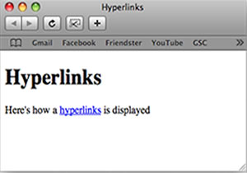
Hyperlinks
The documents within a web site are typically hyperlinked and a navigation system (or menu) permits the user to move between pages.
A simple website could be organized in just one folder, but large websites need to be organized in some manner because of the large number of files.

Slide 16
Relative and Absolute Links
A relative link means that it is relative to the current document. The Web server knows the location of the current document so it knows how to find relative links.
An absolute link defines the location of the document including the protocol required to get the document, the server, the directory and the name of the document.

Slide 17
Relative and absolute Examples
<a href=“notes.html”>Notes</a>
<a href=“/biology/notes.html”>Notes</a>
Relative links
<a href=“http://www.w3.org/Consortium/mission”>
Mission statement</a>
Absolute link

Slide 18
Webpage Development Standards
The World Wide Web Consortium (W3C) is an international community that develops open standards.
An open standard is a standard that is publicly available and has various rights to use associated with it, and may also have various properties of how it was designed (e.g. open process)
The W3C developed the standards for HTML and CSS.

Slide 19

Webpage Development Standards
The W3C mission is to lead the World Wide Web to its full potential by developing protocols and guidelines that ensure the long-term growth of the Web.

Slide 20
Webpage Development Standards
The HTML standards are constantly evolving to meet the needs of Web users. The current standard is HTML5.
The W3C also creates standards for website accessibility, mobile web, etc.
The W3C has a Web Accessibility Initiative (WAI) which develops strategies, guidelines, and resources to help make the Web accessible to people with disabilities.

