Slide 1
Web Page Layout
Concepts for fluid layout

Slide 2
Website Layouts
Most websites have organized their content in multiple columns (formatted like a magazine or newspaper).
Multiple columns are created by using <div> or <table> elements.
Cascading Style Sheets are used to position elements, or to create backgrounds or a colorful look for the pages.
Even though it is possible to create nice layouts with HTML tables, tables were designed for presenting tabular data - NOT as a layout tool!

Slide 3
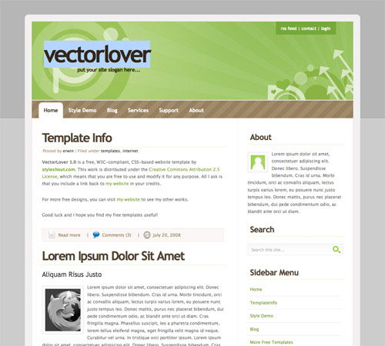
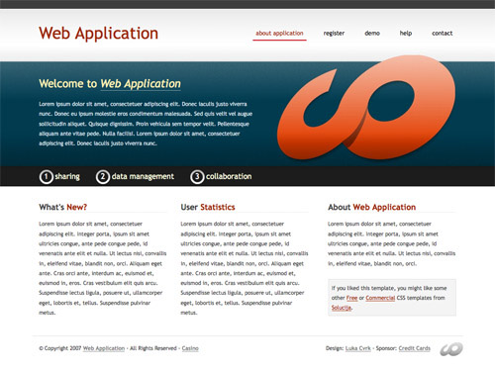
Example Layouts

Slide 4
Layouts that work on many devices
<div> layouts and CSS can create flexible layouts that work on various screen sizes.
Responsive web design is a web design approach aimed at crafting sites to provide an optimal viewing experience—easy reading and navigation with a minimum of resizing, panning, and scrolling—across a wide range of devices.

Slide 5
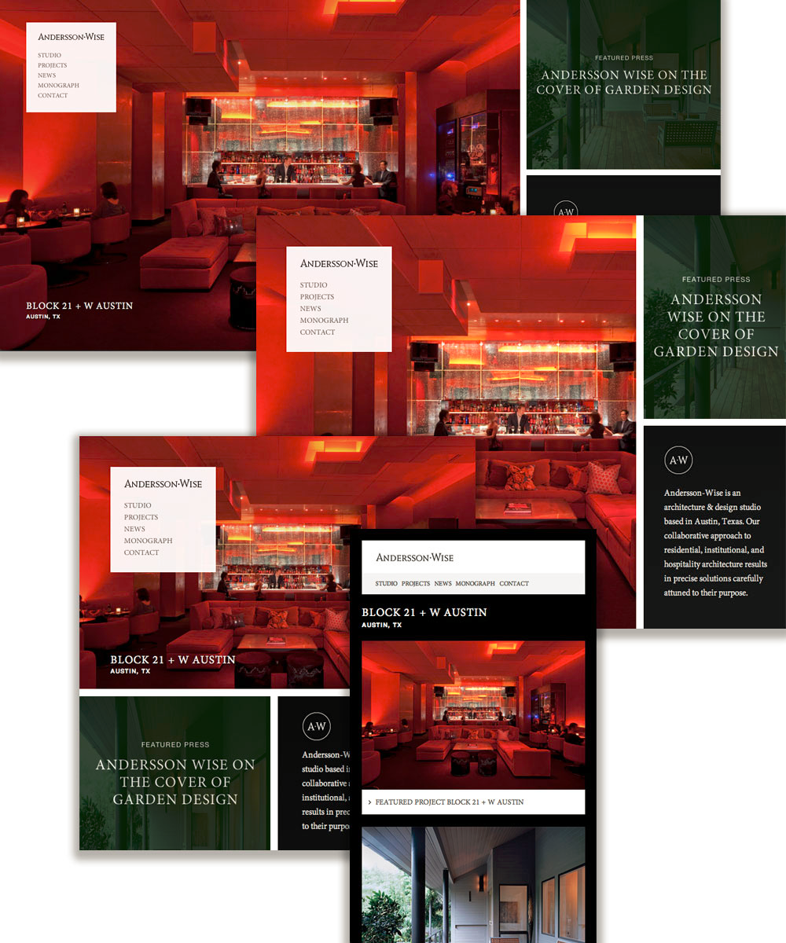
Responsive Web Design
Layout changes to fit the device

Slide 6
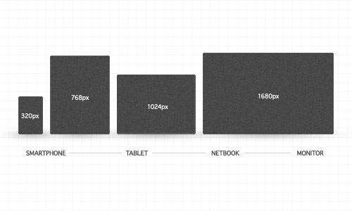
Common resolutions on various devices

Slide 7
Devices vary in resolution and pixel density
As hardware changes, resolution and pixel density change
Web layout needs to be flexible and adjust to various mobile devices and new devices
A pixel is an abstract unit of measurement and it does not have a single specific size.

Slide 8
More than one type of Pixel
Device pixel | Reference pixel | CSS pixel | Bitmap pixel
The smallest physical unit in a display | Reference pixels are based on an optical reference unit and developed by the w3c | CSS pixel is a unit of measure | The smallest unit of data in a raster image.

Slide 9
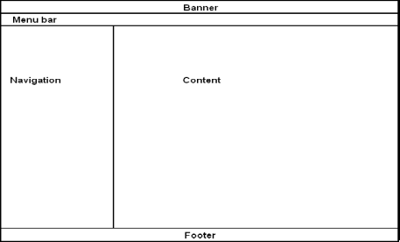
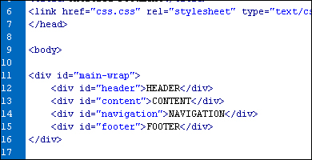
A Popular Page Layout using <div>

Slide 10
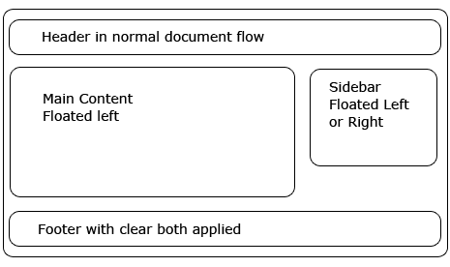
<div> defined
The <div> tag defines a division or a section in an HTML document.
The <div> tag is used to group block-elements to format them with CSS.
The <div> element is very often used together with CSS, to layout a web page

Slide 11
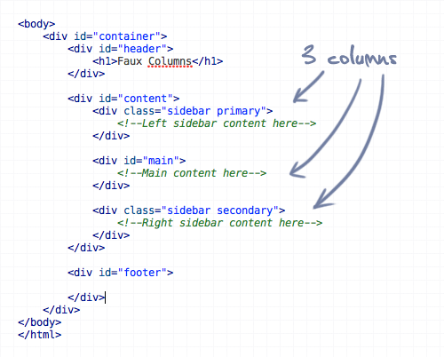
How many <div> elements in this code?

Slide 12
Container div
header div
content div
Footer div
7 div elements

Slide 13
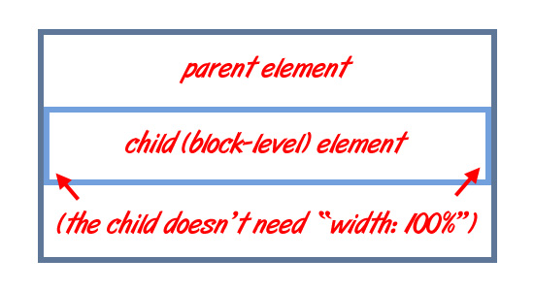
The Power of <div>
Web developers use <div> elements to group together HTML elements and apply CSS styles to many elements at once.

Slide 14
<div> tag and attributes
The <div> tag supports the global attributes in HTML
HTML 5 has introduced some new global attributes
Global attributes can be used on any HTML element

Slide 15
Some examples of global attributes
id - Specifies a unique id for an element
class - Specifies one or more classnames for an element (refers to a class in a style sheet)
style - Specifies an inline CSS style for an element
lang - Specifies the language of the element's content
These are just a few examples. It is not the complete list.

Slide 16

<header> <footer> <nav> are new in html5
A fairly standard layout consists of a banner near the top, navigation, and your content or display box. These are the backbone to any great website.
In HTML5 there is a <header> element, as well as a <nav>, <footer> that can replace these div tags.

Slide 17
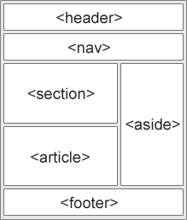
Semantic elements
Many of existing web sites today contains HTML code like this: <div id="nav">, <div class="header">, or <div id="footer">, to indicate navigation links, header, and footer.
HTML5 offers new semantic elements to clearly define different parts of a web page; such as <header>

Slide 18
Container elements
The <header> tag specifies a header for a document or section. The <header> element should be used as a container for introductory content or set of navigational links.
The <footer> tag defines a footer for a document or section. A footer typically contains the author of the document, copyright information, links to terms of use, contact information, etc.
The <nav> tag defines a set of navigation links. It is only intended for a major block of navigation links.

Slide 19
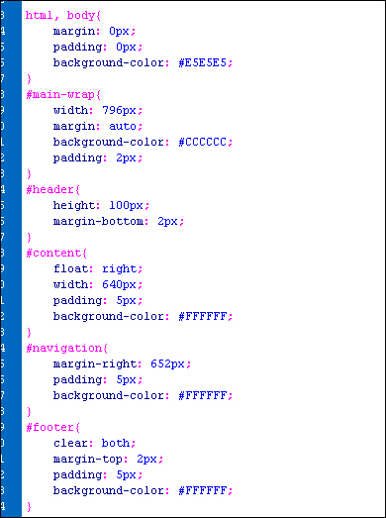
CSS for div
#main-wrap refers to the div id.
The id attribute specifies a unique name

Slide 20
Why use Fixed Layout
A fixed website layout has a wrapper that is a fixed width, and the components inside it have either percentage widths or fixed widths.
The important thing is that the container (wrapper) element is set to not move. No matter what screen resolution the visitor has, he or she will see the same width as other visitors.

Slide 21
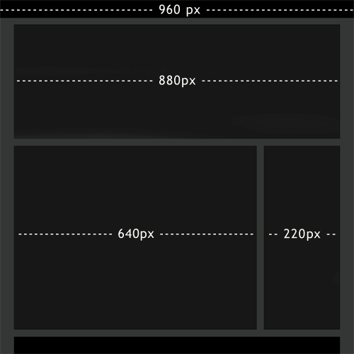
Fixed Layout in Pixels
In this example 960 pixels is the fixed width.
40 px left and right margins
20 px space

Slide 22
Fixed Layout in Pixels
The container div is 960px
The header div is 880px plus 80 pixels of margins.
The Content div and sidebar div plus a 20px space equal 880 px
40 px left and right margins
Header div
Sidebar div
Content div
20 px space
Footer div

Slide 23
From Fixed to Fluid
Compute Percentages and change from pixels to percents
40 px left and right margins
Header 92%
Content div
Sidebar div
73%
25%
20 px space
Footer div

Slide 24
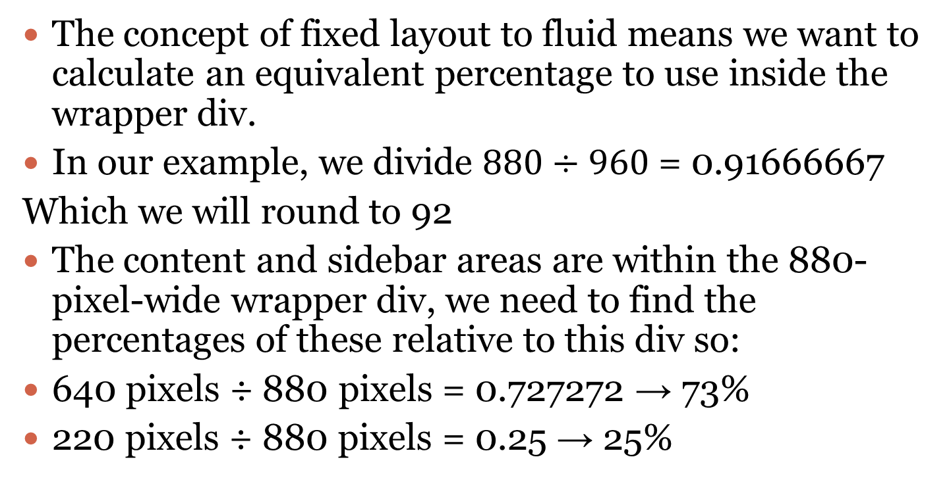
From Fixed Layout to Fluid
The concept of fixed layout to fluid means we want to calculate an equivalent percentage to use inside the wrapper div.
In our example, we divide $880÷960$ = 0.91666667
Which we will round to 92
The content and sidebar areas are within the 880-pixel-wide wrapper div, we need to find the percentages of these relative to this div so:
640 pixels ÷ 880 pixels = 0.727272 → 73%
220 pixels ÷ 880 pixels = 0.25 → 25%

Slide 25
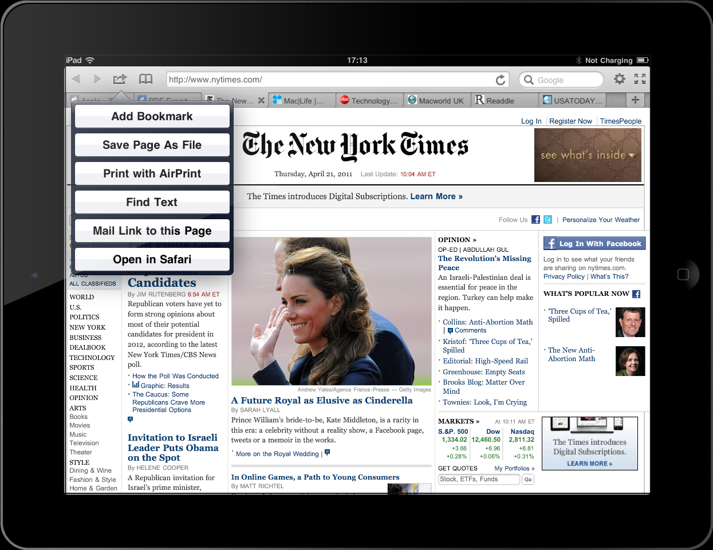
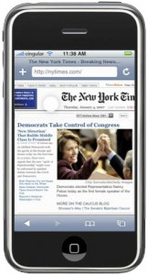
Why consider Fluid Layout
In a fluid website layout, also referred to as a liquid layout, the majority of the components have percentage widths, and thus adjust to the user’s screen resolution.

Slide 26
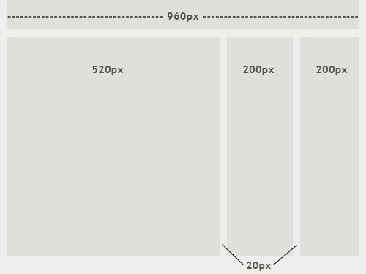
Fixed-Width Layout
520 + 20 + 200 + 20 + 200 = 960 pixels

Slide 27
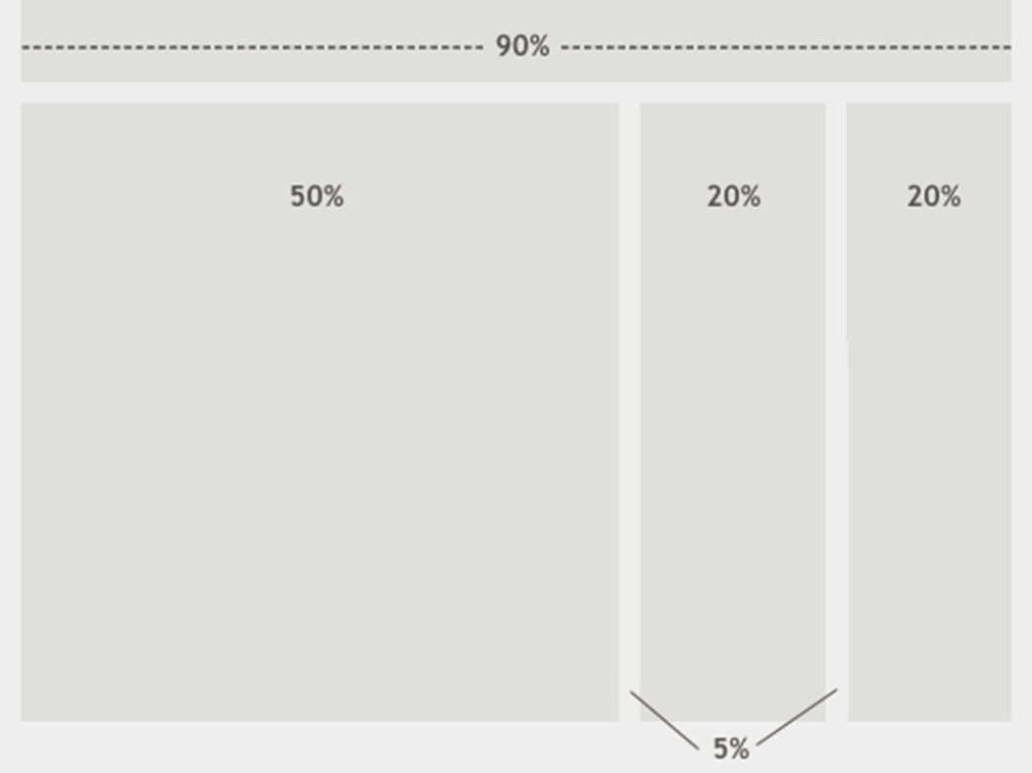
Fluid Layout
200px/960px=20%
520/960=54%
20px/960px=2%

Slide 28
Relative Units
Relative layouts are accomplished by using a relative unit like the em or the percent ("%").
The em is basically the height of the font being used on the page.
It is considered relative because a 16 point font has a different height from, say, a 12 point font.
The percent has the normal meaning you are used to from mathematics. That is, if the width of the page is set to 80%, it means 80% of the maximum width it can have.
It's regarded as relative since the maximum width varies depending on how big your browser window is.
The term “em” is a reference to the Letter “M” in written form.

Slide 29
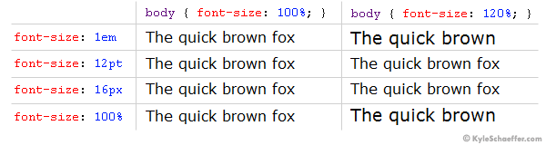
What is an em unit?
“Ems” (em): The “em” is a scalable unit that is used in web document media. An em is equal to the current font-size, for instance, if the font-size of the document is 12pt, 1em is equal to 12pt. Ems are scalable in nature, so 2em would equal 24pt, .5em would equal 6pt, etc. Ems are becoming increasingly popular in web documents due to scalability and their mobile-device-friendly nature.

Slide 30
Factors to consider in Layout
Screen resolution and pixel density
Browser choice
Whether or not the browser is maximized
Extra toolbars open in the browser (History, Bookmarks, etc.)
The operating system and hardware
Notes:
Screen resolution and pixel density vary by the device

Slide 31
Resources
http://coding.smashingmagazine.com/2009/06/02/fixed-vs-fluid-vs-elastic-layout-whats-the-right-one-for-you/
http://www.w3schools.com/
http://kyleschaeffer.com/development/css-font-size-em-vs-px-vs-pt-vs/

