Slide 1
What is SVG?

Slide 2
SVG stands for Scalable Vector Graphics
SVG is used to define vector-based graphics for the Web
SVG defines the graphics in XML format
SVG graphics do NOT lose any quality if they are zoomed or resized
Every element and every attribute in SVG files can be animated
SVG is a W3C recommendation

Slide 3
When using bitmaps
For modern browsers, add "max-width: 100%" to images so they scale down to fit within their containing element in a fluid layout
Bitmap images are composed of a fixed set of dots, while vector images are composed of a fixed set of shapes. Scaling a bitmap reveals the dots while scaling a vector image preserves the shapes.

Slide 4
Remember Bitmap (Raster) and Vector Graphics from an earlier unit?

Slide 5
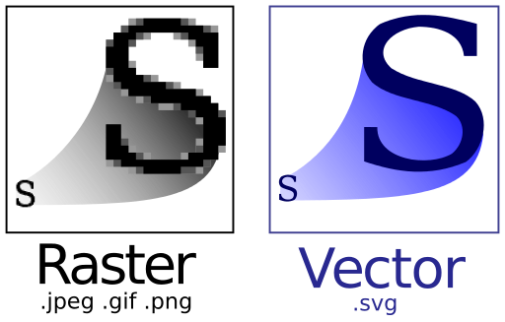
WHY Scalable Images?
Regardless of the method used, raster images remain inherently constrained by their bitmap resolution; they were never meant to be infinitely scalable. This is where vector graphics have the advantage, being a future-proof way to “Retinize” your Web graphics.
A single SVG image can be used as a universal asset, scaling infinitely up or down as required. This not only saves precious bandwidth (most SVG files tend to be smaller in size than standard-resolution PNGs), but also makes your graphic assets much easier to maintain.

Slide 6
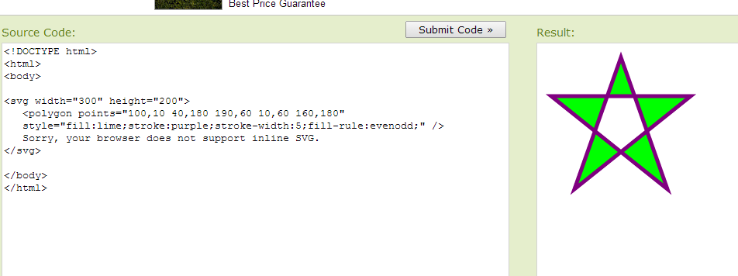
<svg> code

Slide 7
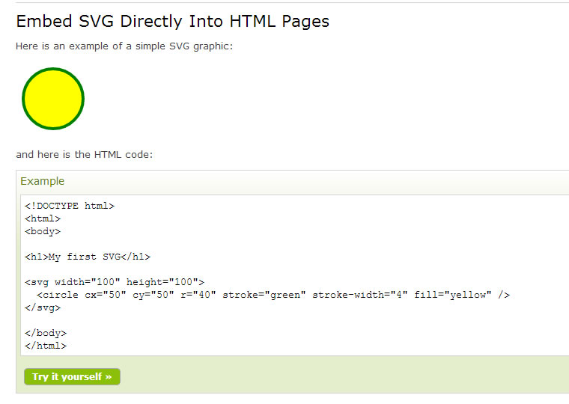
SVG Example

Slide 8
Advantages of using SVG over other image formats (like JPEG and GIF)
SVG images can be created and edited with any text editor
SVG images can be searched, indexed, scripted, and compressed
SVG images are scalable
SVG images can be printed with high quality at any resolution
SVG images are zoomable (and the image can be zoomed without degradation)

Slide 9
What do you see online?
Most images on the Web are bitmaps; also known as raster graphics.
Bitmaps can be pre-scaled or resized so an appropriate size is displayed depending upon the viewport.

Slide 10
Guidelines for Images
Avoid using images with inappropriate resolutions.
Pre-scale images in various resolutions and serve an image appropriate for the viewport.
When images are not scaled appropriately, they will appear blurry when scaled up
Images that are larger than necessary waste battery and cause longer downloads

